Slide 1
Project Lead (PL) Capability Transition and Product Integration (CTPI)
Ground Common Infrastructure Architecture (GCIA) & Trim Level Strategy
Alan Cichosz
Chief Architect, PL CTPI
LTC Nicholas Breen
Product Lead, Ground Combat Product Integration
03 AUG 2022

Slide 2
Project Lead Capability Transition & Product Integration (PL CTPI)
Project Lead Capability Transition & Product Integration (PL CTPI)
  Stood up within PEO GCS to manage vertical and horizontal technology integration to address PM prioritized capability gaps
  Provides holistic integration processes for transition of technology & capabilities onto GCS platforms.
PL CTPI Product Offices:
  PdL Ground Combat Product Integration (GCPI)
  PdL Ground Combat Enabling Technologies & Transition (GCETT)
  PdM Vehicle Protection Systems (VPS)

Slide 3
Architecture Objectives
Ensure consistent MOSA implementation both within and across ground platforms
Reduce time and cost to add or upgrade capabilities on and across future platforms
Enable development and integration of solutions at the hardware/software component level versus entire subsystems
Reduce the need to retest the entire system each time a new component is added or changed

Slide 4
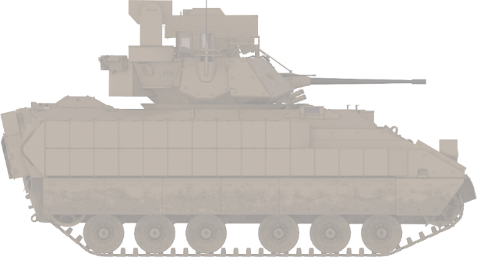
Paradigm Shift
EXAMPLE CURRENT STATE
EXAMPLE FUTURE STATE
Capabilities are subsystem focused
Each subsystem brings end-to-end functionality dedicated to subsystem
Complex integration with limited interoperability
Sensors, processors, displays & effectors are shared
Platform hardware choices based on desired abilities to physically sense, process, maneuver, communicate & deliver effects
Software capabilities are continually added/upgraded
LETHALITY
SUBSYSTEM
SURVIVABILITY
SUBSYSTEM
Sensors (IR)
Sensors (radar)
Effector (laser)
Effector (50mm)
Effector (smoke)
Computing & software
Computing & software
Effector (50mm)
Effector (smoke)
Sensors (IR)
Sensors (camera)
Computing & Software
Lethality
Software
Capabilities
Survivability
Software
Capabilities
Sensors (radar)
Notes:
Key point: Shared computing resources, sensors, etc., rather than duplicating. Platform subsystem capabilities are developed by PORs or OEMs, information and resources are shared. New capabilities require just the sensor/effector and software, limited new hardware and integration.
Expected changes to OEM and system developers business model:
One winning Prime won’t have 30-40 year stranglehold on ECPs
Continuous opportunities for vendors to introduce new technologies and capability upgrades
All contractors should see this as beneficial, but they’ll need to adjust their business model
Emphasize parallels to computer industry (mouse, monitor, GPU become user upgradeable and competitive)
Additional Goals of the Effort
A common hardware (AKA vetronics) and software infrastructure
Avoid redundant or stove-pipe system development and integrations
Avoid non-standard/non-commercial connectors and cables
Enforce sharing resources (e.g., processing) and data across shared network
Enforce the use of configurable and manageable switching technologies
For handling low-latency constraints and safety-critical functions
Enable platform upgrades to a more autonomous system
To facilitate shared data to the AI based systems and other capabilities
Reduce future integration cost and development effort
Enable efficient validation testing and qualification procedures (Cost & Schedule improvements)

Slide 5
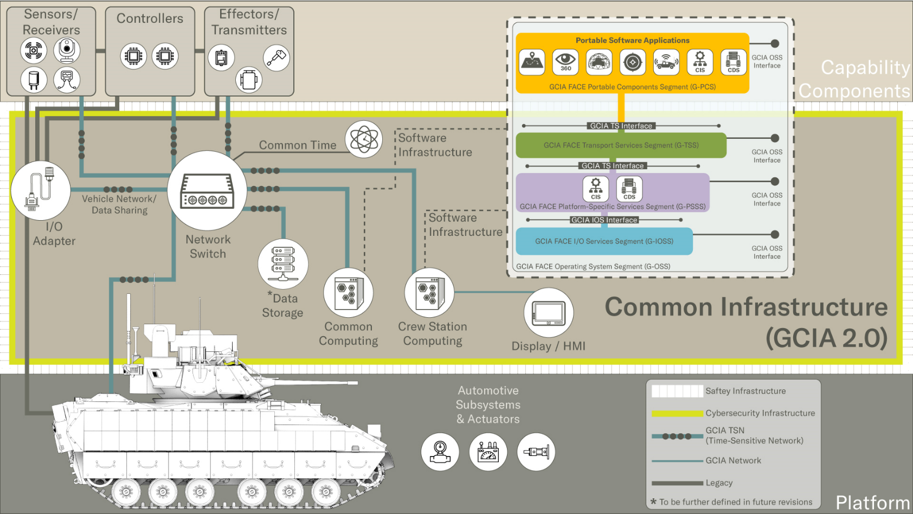
Ground Common Infrastructure Architecture (GCIA)

Slide 6
Ground Combat Trim Level Profiles
U360SA TMI
PBMS TMI
Gray Capabilities
Improve Soldier Safety
Includes baseline capabilities
PNT
Wireless Intercom / Radio
Local Situational Awareness (360 degree) Imagery
  SAVE Slots:
  CMFF Block 1 Capabilities
  Basic 360° SA Capabilities
Combat Capabilities
Improve Platform Lethality & Protection / Human Machine Pairing
Includes gray capabilities
Helmet mounted displays for crew with stitched imagery
Situational Awareness imagery pushed to dismounts
Aided Threat Recognition Software to support Slew-to-cue capabilities
SAVE Slots:
CMFF Block 2 Capabilities
Advanced 360° SA Capabilities
Argos Capabilities
Improve Formation Lethality through Shared Data & more efficient decision making / Human Machine Pairing
Includes gray capabilities
Advanced imagers and processing for threat detection, such as 3rd GEN FLIR and HFD
Vision aided navigation
SAVE Slots:
CMFF Block 3 Capabilities
Advanced SA and Far-Target Capabilities
Command Capabilities
(ABCT OTM Descriptive Info Here)
ABCT OTM
Baseline Capabilities
Standards: SAVE, GCIA,
Vehicle Environmental Requirements
Ground Vehicle Operating System
Wireless Intercom (option)
U360SA TMI:
$77M Platform agnostic situational awareness project being worked with DEVCOM C5ISR RTI to mature the sensor architecture and begin tying into the communication network
Develop computing solution that is GCIA/SAVE complaint, with exploration into CMFF-compliance
Demonstrate capability on GCS platforms at Vehicle Excursion 4 (VE-4) in 4QFY25
U360SA TMI will help lay the foundation and inform the follow-on PBMS TMI
Platform Battle Management System TMI:
Builds upon the U360SA TMI with a focus on unifying software between vehicle sensors and the network architecture
Based off GCIA and CMOSS/CMFF while implementing an Apple Car Play like user interface
Soldiers would interface with the platform and products through “apps” via PBMS
Demonstrate capability on GCS platforms at Vehicle Excursion 5 (tentatively scheduled for 4QFY27)

Slide 7
Architecture Strategy
Future Systems: Ground Common Infrastructure Architecture (GCIA) is a requirement for future systems - starting with OMFV
Enduring Platforms: Incrementally portions of the architecture such as SAVE, CMOSS, FACE etc. to achieve full GCIA implementation over time

Slide 8
How to Participate
Industry can review the latest artifacts and participate in the future of GCIA through the community of interest
National Advanced Mobility Consortium (NAMC) MOSA Community of Interest (COI)
  https://www.namconsortium.org/membership/communities-interest
  Email: Submissions@NAMConsortium.org
GCIA Mailbox: usarmy.detroit.peo-gcs.mbx.gcia@army.mil

